Slide 1
BCSE202L Data Structures and Algorithms Project
Sudarshan N Sankaran
22BCE1045

Slide 2
Maze Solver: A Comparative Study of Pathfinding Algorithms for Maze Solving

Slide 3
Content
Problem Definition
Abstract
Literature survey
Proposed architecture
Design and Algorithm
References

Slide 4
Problem Definition
This project addresses the need for a versatile maze-solving tool that enables users, including students, educators, and developers, to efficiently navigate mazes while comparing the performance of different pathfinding algorithms. It involves efficiently solving mazes with defined Start and Exit points while comparing the performance of multiple pathfinding algorithms. The challenge lies in finding the shortest path while avoiding obstacles within the maze. The project also generates mazes of varying complexities, aiming to help users select the most suitable pathfinding algorithm for their specific maze-solving needs.

Slide 5
Abstract
A Maze is given as N*N binary matrix of blocks where source block is the upper left most block i.e., maze[0][0] and destination block is lower rightmost block i.e., maze[N-1][N-1]. The user starts from source and has to reach the destination and can move only in two directions: forward and down. In the maze matrix, 0 means the block is a dead end and 1 means the block can be used in the path from source to destination. For example, a more complex version can be that the user can move in 4 directions and a more complex version can be with a limited number of moves. The project generates random mazes, and compares algorithm performance in terms of execution time, path length, and memory usage.

Slide 6
This project serves as a valuable tool for users seeking efficient maze-solving solutions across different applications. Performance analysis plays a crucial role in evaluating the efficiency of each algorithm. In this context, various aspects are explored, such as time complexity, space complexity, and the impact of different maze sizes and complexities on the algorithm's execution time. It also presents the results of experiments comparing the performance of the algorithms on a set of test mazes, with the results showing that A* search is the most efficient one out of the four types of algorithms explored in this project in terms of time and space complexity and that it consistently outperforms them in finding the shortest path to the goal node.

Slide 7
Literature Survey
Here are a few research papers that delve into the topic and provide valuable insights into the state of the art and recent advancements in the field:
"A* Search Algorithm" by Peter Hart, Nils Nilsson, and Bertram Raphael.
This seminal paper introduces the A* algorithm, a widely used pathfinding algorithm applicable to maze solving.
Paper Link: https://www.cs.auckland.ac.nz/courses/compsci709s2c/lectures/H120_20.pdf
"A Survey of Path Planning and Solving Techniques for Robotic Mazes" by Marios K. Papachristou
This survey paper provides an overview of various path planning and maze-solving techniques used in robotics.
Paper Link: https://www.researchgate.net/publication/225750225_A_survey_of_path_planning_and_s olving_techniques_for_robotic_mazes

Slide 8
"Solving mazes with parallel processes" by A. C. Yao
This paper explores the use of parallel processing for solving mazes efficiently.
Paper Link: https://dl.acm.org/doi/10.1145/800119.803890
"Robot Navigation in Unknown Terrains by Virtual Sensing" by Avinash Kak
This paper discusses the use of virtual sensing and path planning for maze solving.
Paper Link: https://www.researchgate.net/publication/2426983_Robot_Navigation_in_Unknown_Terrains_by_Virtual_Sensing
"A New Approach to Path Planning for Redundant Robots" by Mark A. Minor and Robert L. Wainwright
This paper discusses path planning for redundant robots, which can be relevant for maze-solving scenarios.
Paper Link: https://journals.sagepub.com/doi/abs/10.1177/027836498800700205

Slide 9
Proposed Architecture
Breadth First Search (BFS)
Depth First Search (DFS)
Dijkstra’s Algorithm
A* (A-star)

Slide 10
Breadth First Search (BFS)
Breadth-First Search is an essential graph traversal algorithm used to explore and search for the shortest path in unweighted graphs or trees. It starts at the root node and explores all neighbor nodes at the current depth level before moving on to deeper levels. BFS is known for its simplicity and guarantee of finding the shortest path in unweighted graphs. It is commonly used in applications where finding the shortest path is essential, such as network routing and maze solving.

Slide 11
Depth First Search (DFS)
Depth-First Search is a graph traversal algorithm that explores as far as possible along a branch before backtracking. It is used to traverse and search tree and graph structures. DFS is memory-efficient as it uses a stack to keep track of visited nodes. DFS is more efficient than BFS for large graphs, but it can be less complete. It is well-suited for tasks like topological sorting, cycle detection, and solving puzzles, but it does not guarantee finding the shortest path, making it less suitable for certain applications like maze solving.

Slide 12
Dijkstra’s Algorithm
Dijkstra's Algorithm is a weighted graph traversal algorithm used for finding the shortest path from a single source node to all other nodes in a graph with non-negative edge weights. It maintains a priority queue to continuously select the node with the smallest tentative distance from the source and updates the distances as it explores the graph. In each iteration, Dijkstra's algorithm removes the node with the smallest distance from the unvisited set and adds it to the visited set. It then updates the distances of all of the neighbors of the removed node. It is primarily suitable for applications like network routing and GPS navigation.

Slide 13
A* (A star)
The A* Algorithm is a complex heuristic-based search algorithm used for finding the shortest path in graphs. It combines the advantages of both BFS and Dijkstra's Algorithm by considering both the actual cost from the start node and an estimated cost to reach the goal node. This allows A* search to focus its exploration on the most promising paths, leading to a shorter path to the goal node. A* intelligently selects nodes to explore based on a priority queue, optimizing efficiency. It is widely used in applications like video games, robotics, and route planning, where efficient pathfinding is crucial.

Slide 14
Design and Algorithm

Slide 15
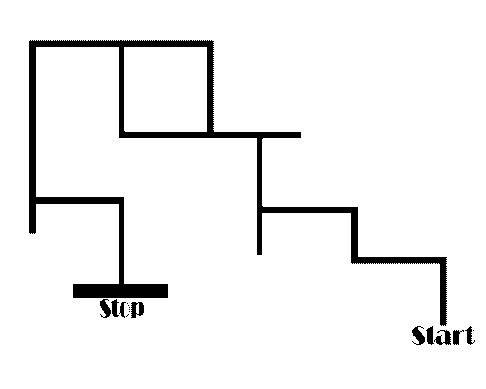
A maze is a tour puzzle in the form of a complex branching passage through which the solver must find a route. To explain it simply, a puzzle with twists and turns, where you try to find a path from the entrance to the exit without hitting dead ends. Both maze and labyrinth denote a complex and confusing series of pathways, but technically the maze is distinguished from the labyrinth, as the labyrinth has a single through-route with twists and turns but without branches. An example of a maze is:

Slide 16
Breadth First Search (BFS)

Slide 17
Algorithm:
Add root node to the queue, and mark it as visited (already explored).
Loop on the queue as long as it's not empty.
Get and remove the node at the top of the queue (current).
For every non-visited child of the current node, do the following:
Mark it as visited.
Check if it's the goal node, If so, then return it.
Otherwise, push it to the queue.
If queue is empty, then goal node was not found.

Slide 18
Depth First Search (DFS)

Slide 19
Algorithm:
Recursive
Iterative
Mark the current node as visited(initially current node is the root node)
Check if current node is the goal, If so, then return it.
Iterate over children nodes of current node, and do the following:
Check if a child node is not visited.
If so, then, mark it as visited.
Go to it's sub tree recursively until you find the goal node(In other words, do the same steps here passing the child node as the current node in the next recursive call).
If the child node has the goal node in this sub tree, then, return it.
If goal node is not found, then goal node is not in the tree.
Add root node to the stack.
Loop on the stack as long as it's not empty.
Get the node at the top of the stack(current), mark it as visited, and remove it.
For every non-visited child of the current node, do the following:
Check if it's the goal node, If so, then return this child node.
Otherwise, push it to the stack.
If stack is empty, then goal node was not found.

Slide 20
Dijkstra

Slide 21
Algorithm:
Assign dis[v] for all nodes = INT_MAX (distance from root node to every other node).
Assign dis[root] = 0(distance from root node to itself).
Add all nodes to a priority queue.
Loop on the queue as long as it's not empty.
In every loop, choose the node with the minimum distance from the root node in the queue(root node will be selected first).
Remove the current chosen node from the queue (vis[current] = true).
If the current chosen node is the goal node, then return it.
For every child of the current node, do the following:
If child node is not already in the queue (already visited), then skip this iteration.
Assign temp = dist[current] + distance from current to child node.
If temp < dist[child], then, assign dist[child] = temp. This denotes a shorter path to child node has been found.
If queue is empty, then goal node was
not found.

Slide 22
A-Star (A*)

Slide 23
Algorithm:
Assign dis[v] for all nodes = INT_MAX (distance from root node + heuristics of every node).
Assign dis[root] = 0 + heuristic(root, goal) (distance from root node to itself + heuristics).
Add root node to priority queue.
Loop on the queue as long as it's not empty.
In every loop, choose the node with the minimum distance from the root node in the queue + heuristic (root node will be selected first).
Remove the current chosen node from the queue (vis[current] = true).
If the current node is the goal node, then return it.
For every child of the current node, do the following:
Assign temp = distance(root, current) + distance(current, child) + heuristic(child, goal).
If temp < dis[child], then, assign dist[child] = temp. This denotes a shorter path to child node has been found.
And, add child node to the queue if not already in the queue (thus, it's now marked as not visited again).
If queue is empty, then goal node was not found.

Slide 24
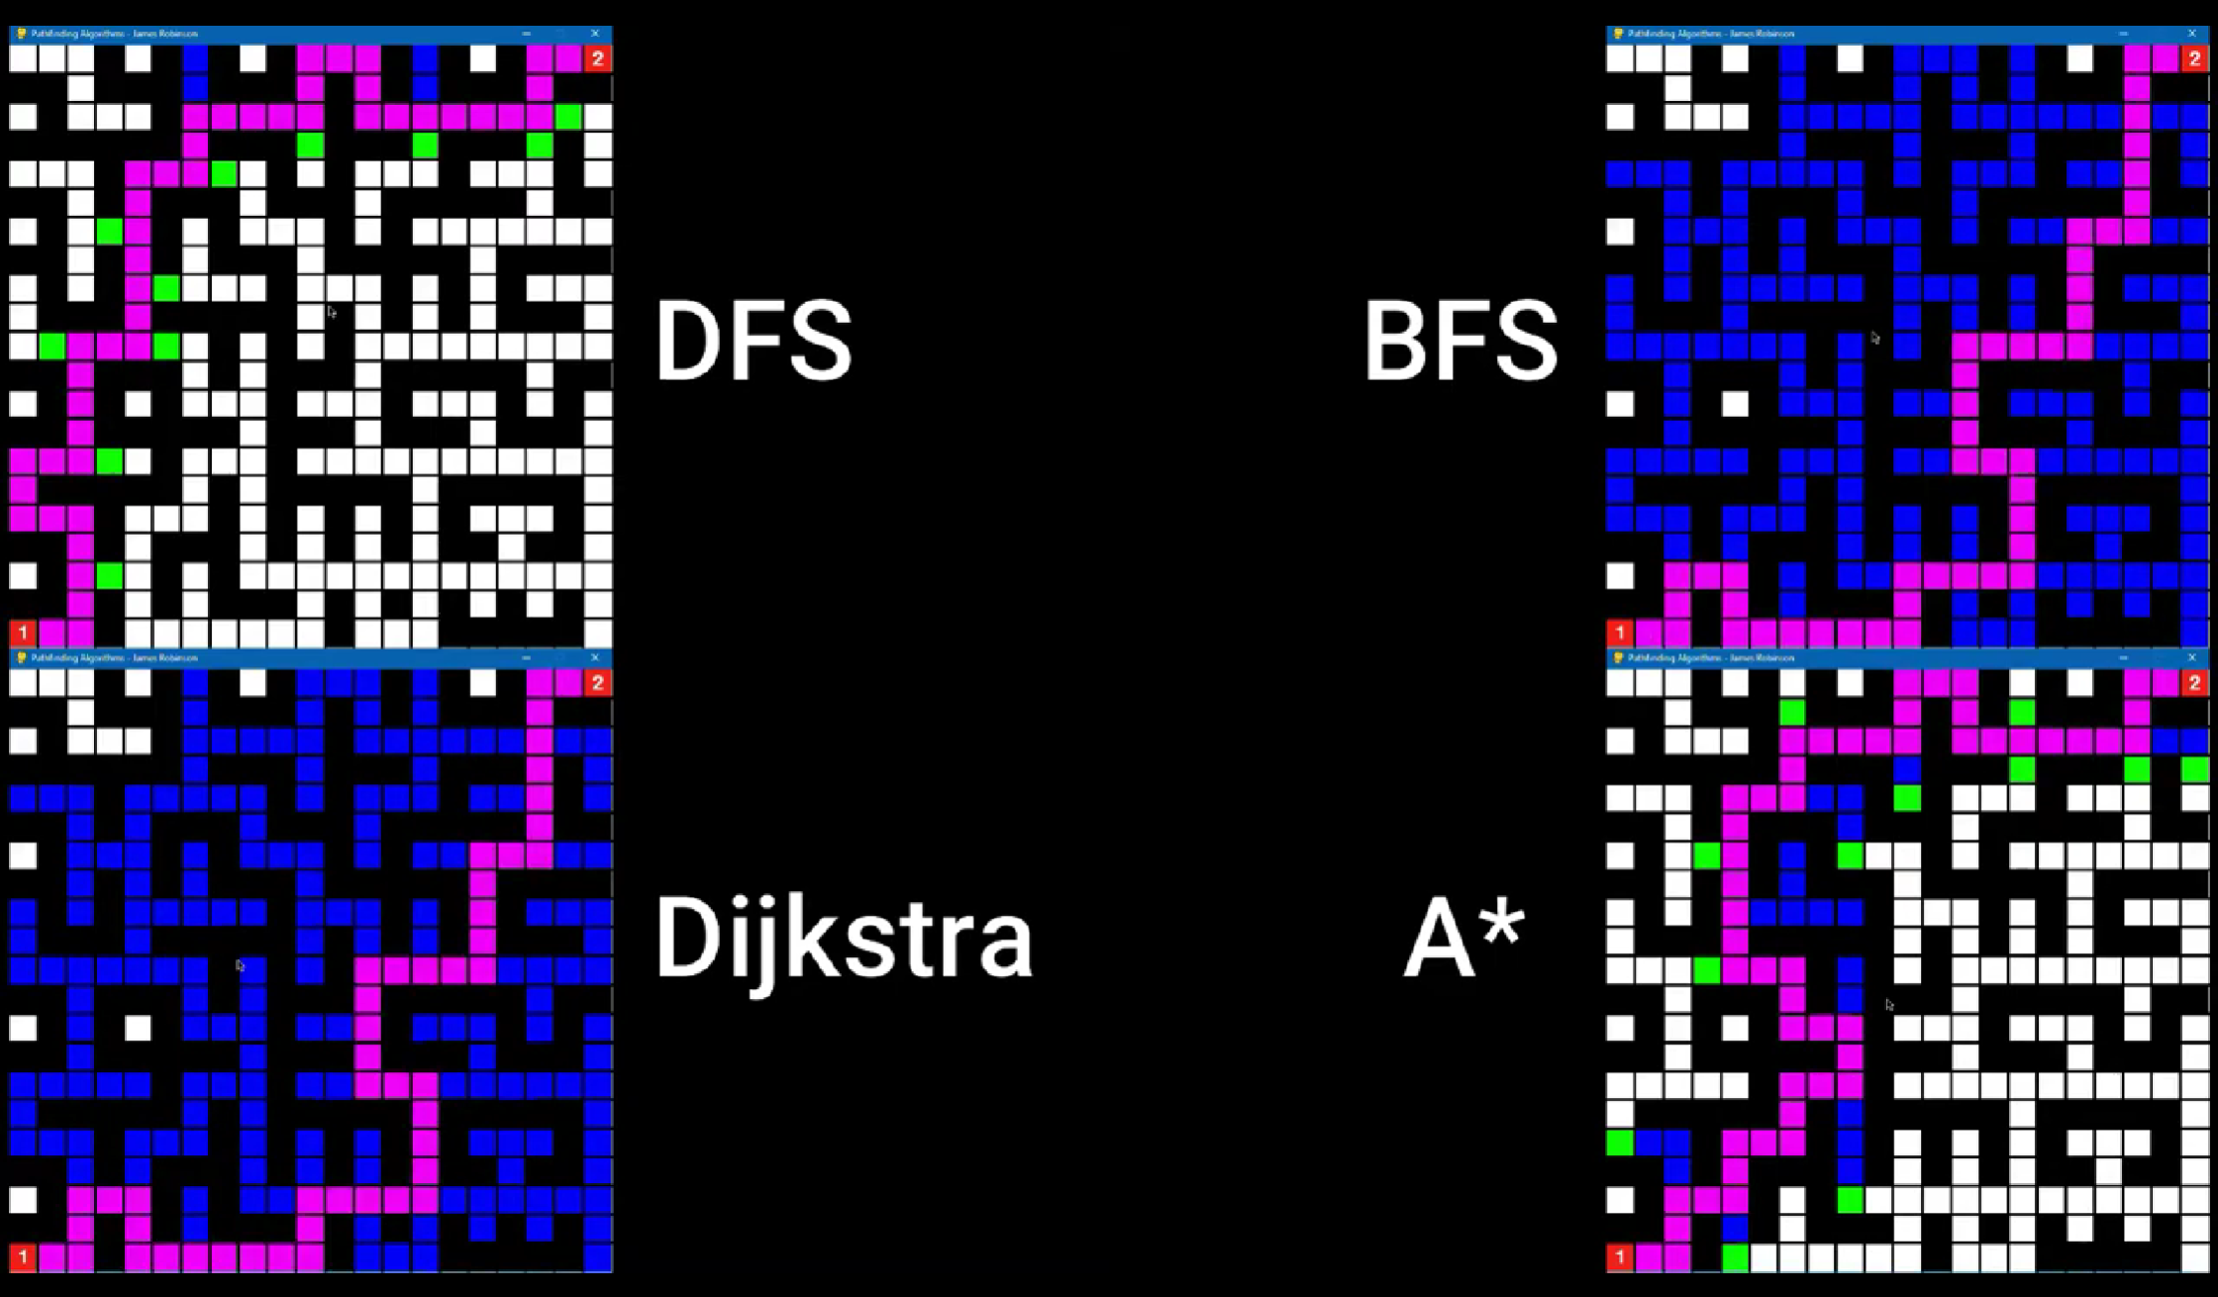
Comparison of the algorithms:
Reference: https://www.youtube.com/watch?v=aW9kZcJx64o&ab_channel=JamesRobinson

Slide 25
References
https://github.com/
https://sourceforge.net/
https://saturncloud.io/blog/
https://medium.com/
https://stackoverflow.com/
https://www.programiz.com/dsa/
https://towardinfinity.medium.com/
https://www.geeksforgeeks.org/
https://www.khanacademy.org/computing/

Slide 26
THANK YOU

